Slide 1


Model dependent and model independent considerations on two photon exchange
Egle Tomasi-Gustafsson
IRFU, SPhN-Saclay,
and
IN2P3- IPN Orsay France

Slide 2
Plan
Introduction
  Generalities
Model independent considerations
  Space-like
  Time-like
Model dependent considerations
What do data say?
Which alternative for GEp problem?
Conclusions

Slide 3
Two-Photon exchange
1γ-2γ interference is of the order of a=e²/4p=1/137 (in usual calculations of radiative corrections, one photon is ‘hard’ and one is ‘soft’)
“Invent a mechanism” to enhance this contribution
In the 70’s it was shown [J. Gunion and L. Stodolsky, V. Franco, F.M. Lev, V.N. Boitsov, L. Kondratyuk and V.B. Kopeliovich, R. Blankenbecker and J. Gunion] that, at large momentum transfer, due to the sharp decrease of the FFs, if the momentum is shared between the two photons, the 2γ- contribution can become very large.
The 2γ amplitude is expected to be mostly imaginary.
In this case, the 1γ-2γ interference is more important in time-like region, as the Born amplitude is complex.

Slide 4



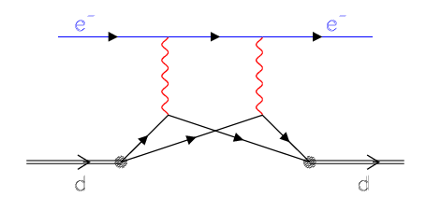


Qualitative estimation of 2γ exchange
For ed elastic scattering:
q/2
q/2
From quark counting rules: F_{d} ~ t⁻⁵ and F_{N}~t⁻² . At t = 4 GeV²
For d, ³He, ⁴He, 2γ effect should appear at ~1 GeV²,
for protons ~ 10 GeV²

Slide 5
Two-Photon exchange in ed-scatterng
Discrepancy between the results from
  Hall A [L.C. Alexa et al., P.R.L. 82, 1374 (1999)]
  Hall C [D. Abbott et al., P.R.L. . 82, 1379 (1999)].
Model-independent parametrization of the
2γ− contribution.
Applied to ed-elastic scattering data.
  M. P. Rekalo, E. T-G and D. Prout, Phys. Rev. C60, 042202 (1999)

Slide 6
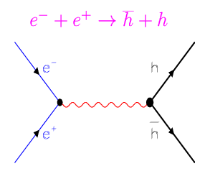
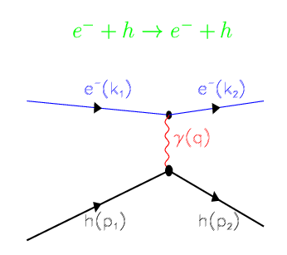

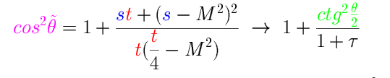
Crossing Symmetry
Scattering and annihilation channels:
- Described by the same amplitude :
- function of two kinematical variables
- which scan different kinematical regions
k₂ → – k₂
p₂ → – p₁

Slide 7

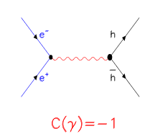


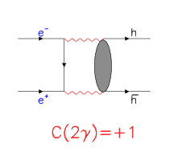


1γ-2γ interference
M. P. Rekalo, E. T.-G. and D. Prout Phys. Rev. C (1999)
1γ
2γ
{
{
1{g

Slide 8
The 1γ-2γ interference destroys the linearity of the Rosenbluth plot!
What about data?

Slide 9
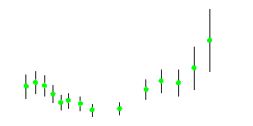
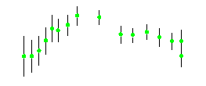
1γ-2γ interference
C/A
D/A
  M. P. Rekalo, E. T-G and D. Prout, Phys. Rev. C60, 042202 (1999)

Slide 10

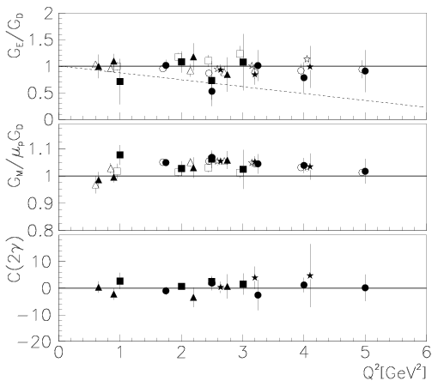
Parametrization of 2γ-contribution for e+p
From the data:
deviation from linearity
<< 1%!
E. T.-G., G. Gakh, Phys. Rev. C 72, 015209 (2005)

Slide 11


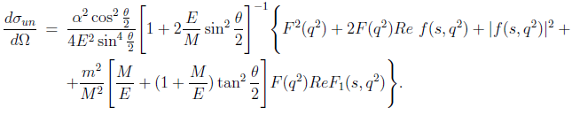
e+⁴He scattering
G.I Gakh, and E. T.-G., Nucl.Phys. A838 (2010) 50-60
Spin 0 particle: F(q²) in Born approximation
2γ exchange : F₁(s,q²),F₂(s,q²)=F(q²) +f(s,q²)
F(q²)~α⁰, F₁(s,q²)~α

Slide 12

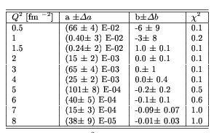
Linear fit to e+⁴He elastic scattering
G.I Gakh, and E. T.-G., Nucl.Phys. A838 (2010) 50-60

Slide 13
Interaction of 4 spin ½ fermions
16 amplitudes in the general case.
P- and T-invariance of EM interaction,
helicity conservation,
One-photon exchange:
- Two form factors (real in SL, complex in TL)
- Functions of one variable (t)
Two-photon exchange:
- Three (complex) amplitudes
- Functions of two variables (s,t)

Slide 14
Is it still possible to extract
the « real » FFs in presence
of 2γ exchange?
Space-like region
Possible but difficult!

Slide 15
Model independent considerations for
e± N scattering
Determination of EM form factors,
in presence of 2γ exchange:
  electron and positron beams
  - longitudinally polarized ,
  - in identical kinematical conditions,
M. P. Rekalo, E. T.-G. , EPJA (2004), Nucl. Phys. A (2003)

Slide 16
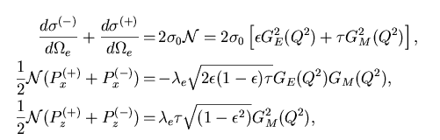
Model independent considerations for e± N scattering
Determination of EM form factors, in presence of 2g exchange
  - electron and positron beams,
  - longitudinally polarized ,
  - in identical kinematical conditions,
Generalization of the polarization method
(A. Akhiezer and M.P. Rekalo)
  M. P. Rekalo and E. T-G Nucl. Phys. A740 (2004) 271,
  M. P. Rekalo and E. T-G Nucl. Phys. A742 (2004) 322

Slide 17
If no positron beam…
Either three T-odd polarization observables….
Ay: unpolarized leptons, transversally polarized
target or
Py: outgoing nucleon polarization with
unpolarized leptons, unpolarized target
Depolarization tensor (Dab): dependence of the
b-component of the final nucleon
polarization on the a-component of the nucleon
target with longitudinally polarized leptons
  M. P. Rekalo and E. T-G Nucl. Phys. A740 (2004) 271,
  M. P. Rekalo and E. T-G Nucl. Phys. A742 (2004) 322

Slide 18

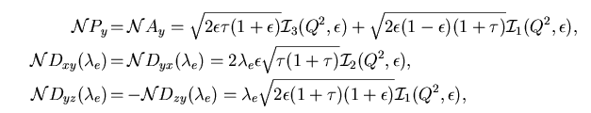

If no positron beam…
Either three T-odd polarization observables….
  M. P. Rekalo and E. T-G Nucl. Phys. A740 (2004) 271,
  M. P. Rekalo and E. T-G Nucl. Phys. A742 (2004) 322

Slide 19

If no positron beam…
This ratio contains the ‘TRUE ‘form factors!
Very difficult experiments
Three T-odd polarization observables….
Expected small, of the order of a, triple spin correlations
but… Model independent way

Slide 20
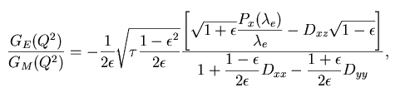
If no positron beam…
Either three T-odd polarization observables….
..or five T-even polarization observables….
among dσ/dΩ, Px(λe), Pz(λe), Dxx, Dyy, Dzz, Dxz
Again very difficult experiments
Only Model independent ways (without positron beams)
  M. P. Rekalo and E. T-G Nucl. Phys. A740 (2004) 271,
  M. P. Rekalo and E. T-G Nucl. Phys. A742 (2004) 322

Slide 21
Is it still possible to extract
the « real » FFs in presence
of 2γ exchange?
Time-like region
much easier!

Slide 22
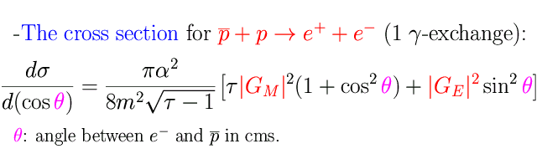
Time-like observables: | G_{E}| ² and | G_{M}| ²
A. Zichichi, S. M. Berman, N. Cabibbo, R. Gatto, Il Nuovo Cimento XXIV, 170 (1962)
B. Bilenkii, C. Giunti, V. Wataghin, Z. Phys. C 59, 475 (1993).
G. Gakh, E.T-G., Nucl. Phys. A761,120 (2005).
As in SL region:
- Dependence on q² contained in FFs
- Even dependence on cos²θ (1γ exchange)
- No dependence on sign of FFs
- Enhancement of magnetic term
but TL form factors are complex!

Slide 23


Unpolarized cross section
Two Photon Exchange:
Induces four new terms
Odd function of θ:
Does not contribute at θ =90°
M.P. Rekalo and E. T.-G., EPJA 22, 331 (2004)
G.I. Gakh and E. T.-G., NPA761, 120 (2005)

Slide 24

Symmetry relations
Properties of the TPE amplitudes with respect to the transformation: cos θ = - cos θ i.e., θ → π - θ
(equivalent to non-linearity in Rosenbluth fit)
Based on these properties one can remove or single out TPE contribution
E. T.-G., G. Gakh, NPA (2007)

Slide 25

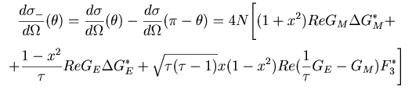

Symmetry relations (annihilation)
Differential cross section at complementary angles:
The SUM cancels the 2γ contribution:
The DIFFERENCE enhances the 2γ contribution:

Slide 26
What do data say?

Slide 27

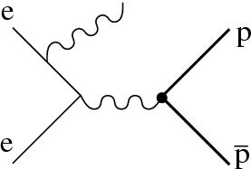
Radiative Return (ISR)
e⁺ +e⁻ → p + p + γ
B. Aubert ( BABAR Collaboration) Phys Rev. D73, 012005 (2006)

Slide 28

Angular distribution
1.877÷1.950
1.950÷2.025
2.025÷2.100
2.100÷2.200
2.200÷2.400
Events/0.2 vs. cos θ
2.400÷3.000
    2γ−exchange?

Slide 29
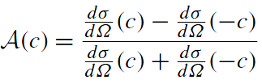
Angular Asymmetry
Mpp=1.877-1.9
A=0.01±0.02
Mpp=2.4-3
E. T.-G., E.A. Kuraev, S. Bakmaev, S. Pacetti, Phys. Lett. B (2008)

Slide 30



Structure Function method
e⁺ +e⁻ → p + p + γ
E.A. Kuraev, V. Meledin, Nucl; Phys. B
ΔE=0.05
E. T.-G., E.A. Kuraev, S. Bakmaev, S. Pacetti, Phys. Lett. B (2008)

Slide 31




Fitting the angular distributions...
The form of the differential cross section:
is equivalent to:
Cross section at 90⁰
Angular asymmetry
E. T-G. and M. P. Rekalo, Phys. Lett. B 504, 291 (2001)

Slide 32

Fitting the angular distributions...
1 γ exchange:
Linear Fit in cos²θ
2 γ exchange
Quadratic Fit in x=cosθ
E. T-G. and M. P. Rekalo, Phys. Lett. B 504, 291 (2001)

Slide 33
Fitting the angular distributions...
q²=5.4 GeV²
2γ 0
Forward
Backward

Slide 34
Fitting the angular distributions...
q²=5.4 GeV²
2γ 0.02

Slide 35
Fitting the angular distributions...
q²=5.4 GeV²
2γ 0.05

Slide 36
Fitting the angular distributions…
q²=5.4 GeV²
2γ 0.20

Slide 37
Which alternative for Gep?

Slide 38
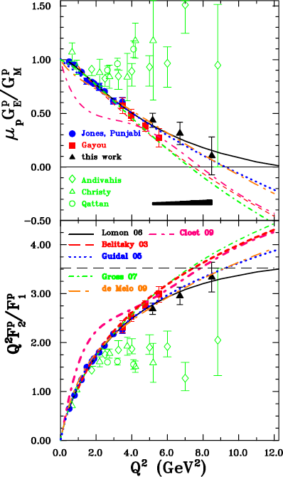
Polarization experiments - Jlab
A.I. Akhiezer and M.P. Rekalo, 1967
  GEp collaboration
  "standard" dipole function for the nucleon magnetic FFs GMp and GMn
  2) linear deviation from the dipole function for the electric proton FF Gep
  3) QCD scaling not reached
  3) Zero crossing of Gep?
  4) contradiction between polarized and unpolarized measurements
  A.J.R. Puckett et al, PRL (2010)
  PRC85 (2012) 045203

Slide 39
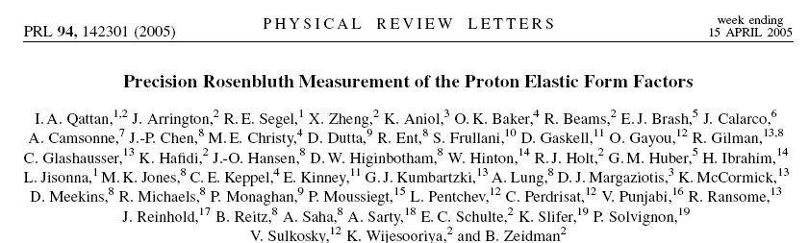
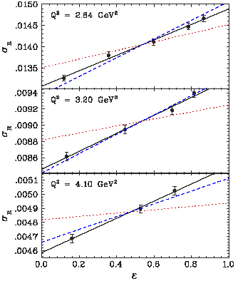
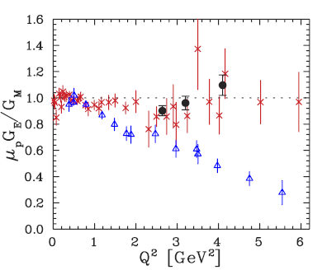
WHY these points are aligned?

Slide 40


Rosenbluth separation
Contribution of the electric term
ε=0.8
…to be compared to the absolute value of the error on σ and to the size and ε dependence of RC
ε=0.2
ε=0.5
  E.T-G, Phys. Part. Nucl. Lett. 4, 281 (2007)

Slide 41
Reduced cross section and RC
Data from L. Andivahis et al., Phys. Rev. D50, 5491 (1994)
Q²=1.75 GeV²
Q²=2.5 GeV²
Q²=3.25 GeV²
Q²=4 GeV²
Q²=5 GeV²
Q²=6 GeV²
Slope from P. M.
Q²=7 GeV²
Radiative Corrected data
Raw data without RC
E. T.-G., G. Gakh Phys. Rev. C (2005)

Slide 42
Radiative Corrections (ep)
Andivahis et al., PRD50, 5491 (1994)
Q²=1.75 GeV²
Q²=3.75 GeV²
May change
the slope of σ_{R}
(and even the sign !!!)
Q²=5 GeV²
RC to the cross section:
− large (may reach 40%)
ε and Q² dependent
− calculated at first order
C.F. Perdrisat,, Progr. Part. Nucl. Phys. 59,694 (2007)

Slide 43
Experimental correlation
σ_{el}=σ_{meas} · RC
RC(ε)
only published values!!
Correlation (<RC•ε>)
Q² > 2 GeV²
Q² < 2 GeV²

Slide 44

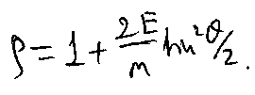
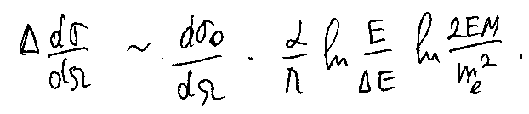
Scattered electron energy
final state emission
Initial state emission
Quasi-elastic scattering
3%
Not so small!
Shift to LOWER Q²
Y₀
All orders of PT needed →
beyond Mo & Tsai approximation!

Slide 45
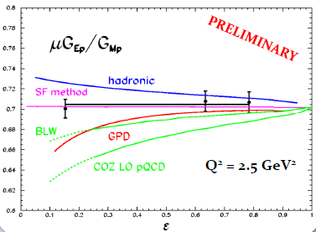
Polarization ratio (ε-dependence)
DATA: No evidence
of ε-dependence at 1% level
MODELS: large correction (opposite sign) at small ε
SF method: ε-independent corrections
•Theory: corrections to the Born approximation at Q2= 2.5 GeV2
Y. Bystritskiy, E.A. Kuraev and E.T.-G, Phys.Rev.C75: 015207 (2007)
P. Blunden et al., Phys. Rev. C72:034612 (2005) (mainly GM)
A. Afanasev et al., Phys. Rev. D72:013008 (2005) (mainly GE)
N.Kivel and M.Vanderhaeghen, Phys. Rev. Lett.103:092004 (2009). (high Q₂)

Slide 46
Summary
Our Suggestion for search of 2γ effects:
Search for model independent statements (M.P. Rekalo, G. Gakh..)
Exact calculation in frame of QED (p~μ)
Prove that QED box is upper limit of QCD box diagram
Study analytical properties of the Compton amplitude
Compare to experimental data
Our Conclusions for elastic ep scattering
Two photon contribution is negligible (real part) (E.A. Kuraev)
Radiative corrections are huge: take into account higher order effects (Structure Functions method) ) (Yu. Bystricky)
Look for Multiple Photon Exchange in e-A scattering
Small angle e, or p or pbar - Heavy ion scattering
E.A. Kuraev, M. Shatnev, E.T-G., PRC80 (2009) 018201
2γ effects are expected to be larger in TL region (complex nature)

Slide 47
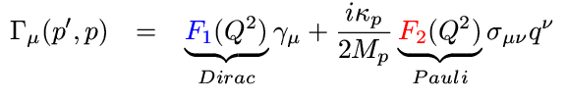
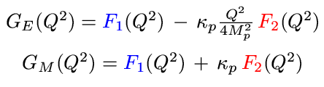
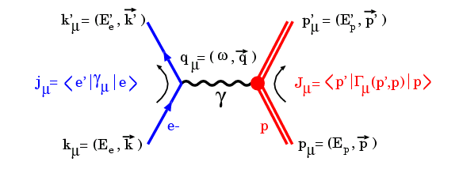
The Pauli and Dirac Form Factors
The electromagnetic current in terms of the Pauli and Dirac FFs:
Normalization
F_{1p}(0)=1, F_{2p}(0)= κ_{p}
Related to the Sachs FFs :
G_{Ep}(0)=1, G_{Mp}(0)=μ_{p}=2.79

Slide 48
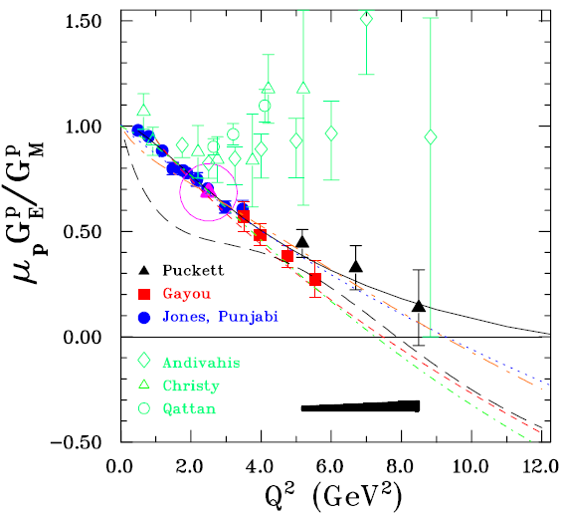
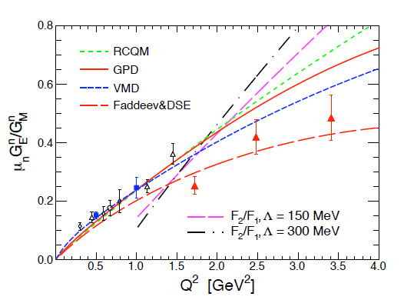
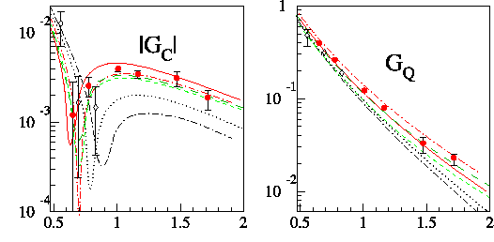
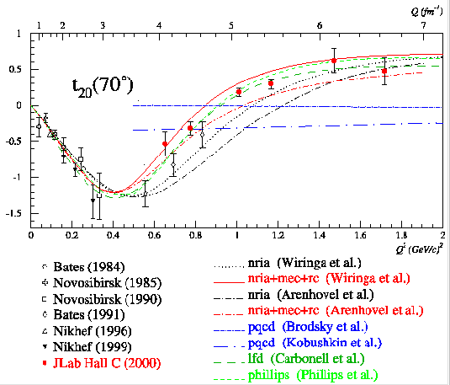
Systematics

Slide 49
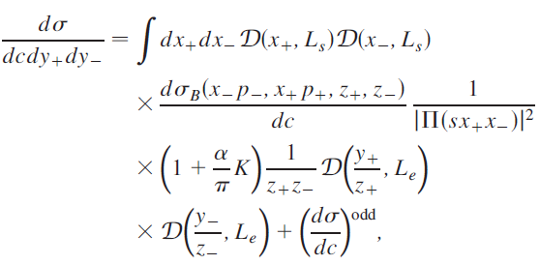
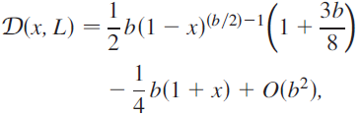

Differential cross section (SF)
Energy fractions of the leptons
K-factor
Partition function
Odd term
The structure function of the lepton

Slide 50

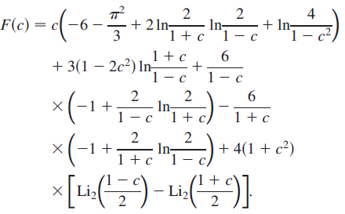
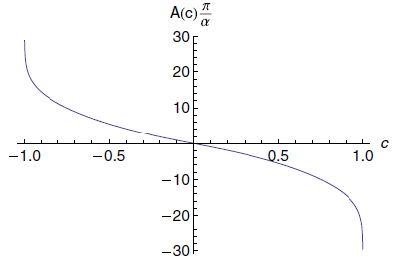

Charge Asymmetry

Slide 51
K-factor (hard)
cos θ
of the order of one
from the even part of the cross section

Slide 52
Radiative correction factor
Ν_{corr}=Ν_{raw}(1+δ)
s=10 GeV²
δ
cos θ
Integrated in all phase space for γ
Proton structureless

Slide 53



QED versus QCD
electron
proton
Imaginary part of the 2γ amplitude

Slide 54


QED versus QCD
Q²=0.05 GeV²
Q²=1.2 GeV²
Q²=2 GeV²

Slide 55
Interference of 1γ ⊗2γ exchange
Explicit calculation for structureless proton
  The contribution is small, for unpolarized and polarized ep scattering
  Does not contain the enhancement factor L
  The relevant contribution to K is ~ 1
eμ (elastic) scattering is upper limit for ep
  E.A.Kuraev, V. Bytev, Yu. Bystricky, E.T-G , Phys. Rev. D74 013003 (1076)

Slide 56
Simulations
q²=5.4,8.2,13.8 GeV²
Main effect:
odd cosθ−distribution
Approximations:
  Neglect contributions to GE,GM
  Consider only real part

Slide 57
1γ
2γ
0.02
0.05
0.20
q²=5.4 GeV²
q²= 8.2 GeV²
q²=13.8 GeV²

Slide 58
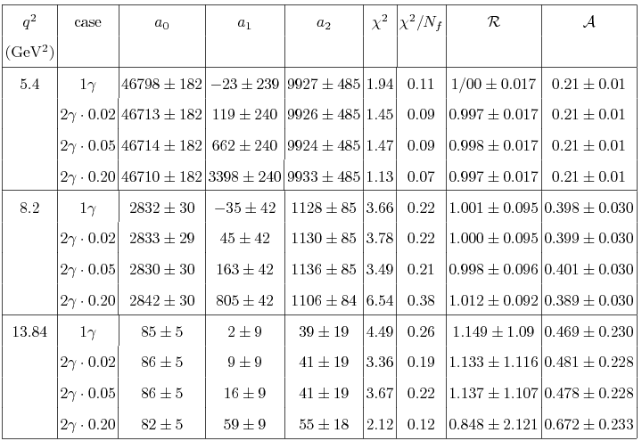
N=a₀+a₂cosθ sinθ +a₁ cos²θ, a₂~2γ

