Slide 1
Search for two-photon effects in charge asymmetry measurements from electron and positron scattering on nucleon and nuclei
E. Tomasi-Gustafsson^{1,2}, M. V. Osipenko³, E. A. Kuraev⁴, Yu. M. Bystritskiy⁴
¹ CEA,IRFU,SPhN, Saclay, France
² CNRS/IN2P3, Institut de Physique Nucleaire, Orsay, France
³ I.N.F.N., Genova, Italy
⁴ Bogoliubov Laboratory of Theoretical Physics, JINR Dubna, Russia
OLYMPUS Workshop
"Experimental and theoretical aspects of the proton form factors"
9-11 July 2012

Slide 2
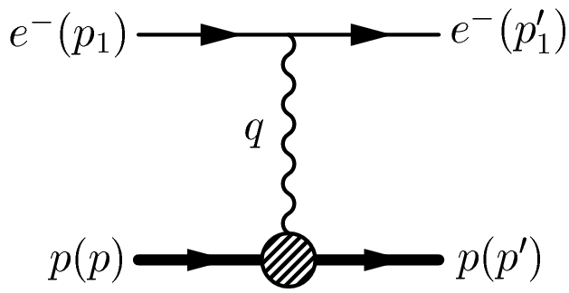
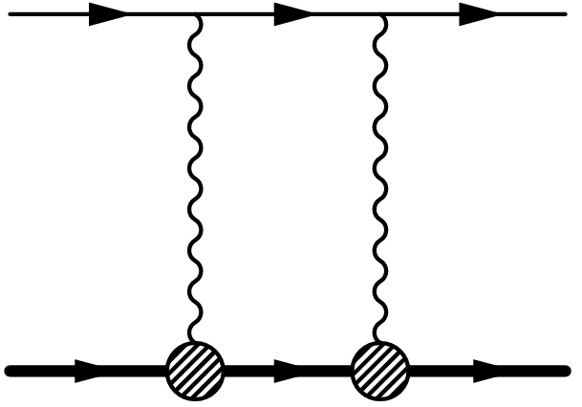
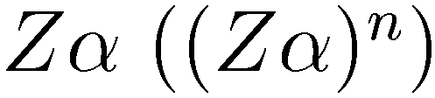
Introduction
The elastic electron-hadron scattering is one of the object of large experimental and theoretical effort since many decades. Most of the interpretation of the observables is based on the assumption that the interaction of the lepton with a hadron occurs through the exchange of one virtual photon (the so called One-Photon-Exchange (OPE) approximation).
Since the early sixties it was noted in the literature that the Two (n)-Photon Exchange (TPE) could also contribute to the observables, although the size of its amplitude would be scaled by the factor .

Slide 3

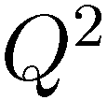

Introduction
In order to find experimental evidence for the processes beyond OPE one has to base on various theoretical predictions.
First of all TPE is proportional to the target charge , hence a nuclear target is desirable.
In J. Gunion, L. Stodolsky, Phys. Rev. Lett. 30, 345 (1973);
V. Franco, Phys. Rev. D8, 826 (1973);
N. Boitsov, L.A. Kondratyuk, and V. B. Kopeliovich, Sov. J. Nucl. Phys. 16, 287 (1973);
F. M. Lev, Sov. J. Nucl. Phys. 21, 45 (1973) it was suggested that a possible large effect from the TPE could arise at large . In this kinematics the factor may be compensated by the steep increase of proton form factors (FFs), if the transferred momentum is equally shared between the two photons.

Slide 4
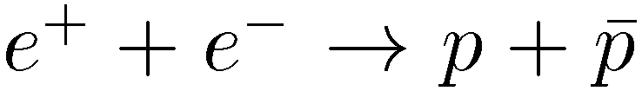
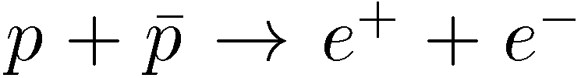

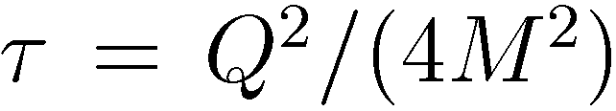


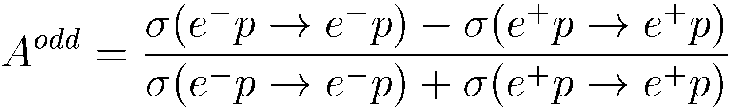
Introduction
Suggested processes for the search of TPE contribution are the elastic lepton scattering off the proton or nuclei and the crossed channels (annihilation processes and ).
The unpolarized elastic scattering provides signatures which give model independent information on the presence of TPE:
1. Non-linearities in the Rosenbluth plot, i.e., in the reduced cross section versus at fixed where is the linear polarization of the virtual photon, , is the proton mass, and s is the angle of the scattered electron in the laboratory (lab) reference frame.
2. Non-vanishing lepton-charge asymmetry which is defined as:

Slide 5
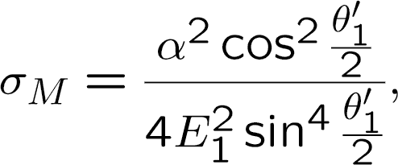
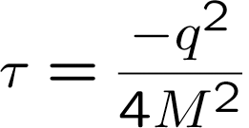
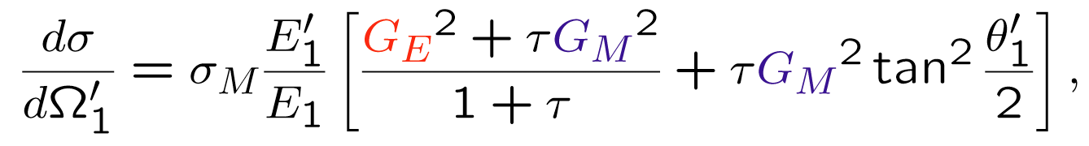
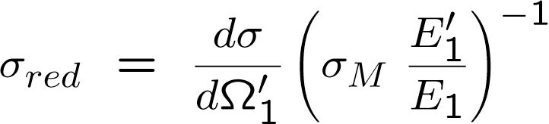
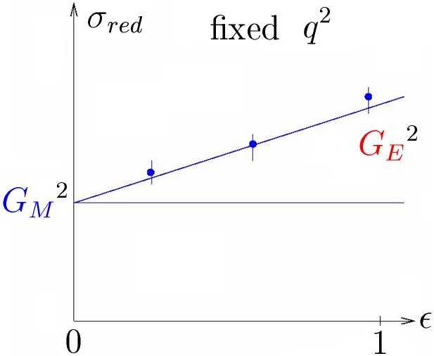
Introduction: Notations
1. Rosenbluth method:

Slide 6
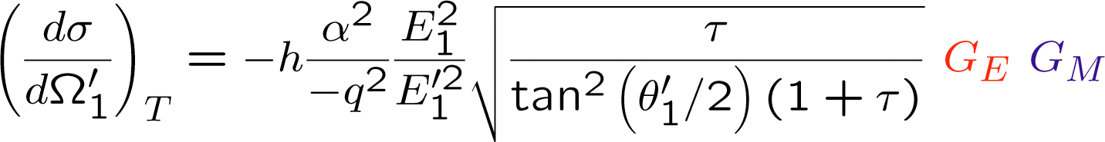
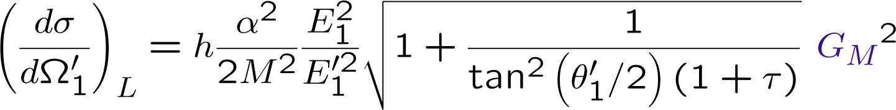
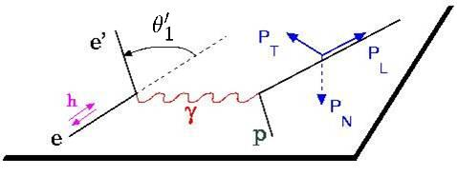
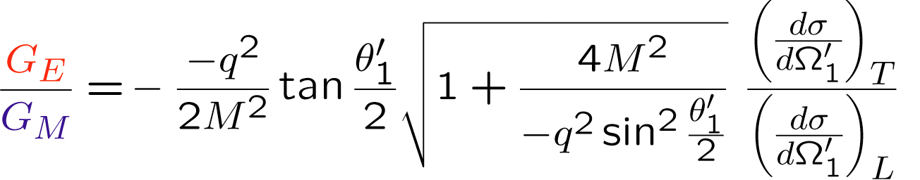
Introduction: Notations
2. Polarized cross section:
А. И. Ахиезер, М. П. Рекало,
Доклады Академии Наук СССР,
т. 180, № 5, стр. 1081, 1968 г.

Slide 7
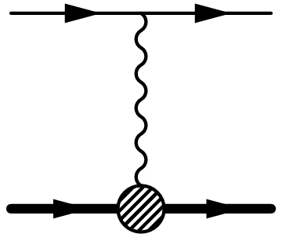
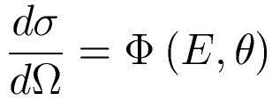
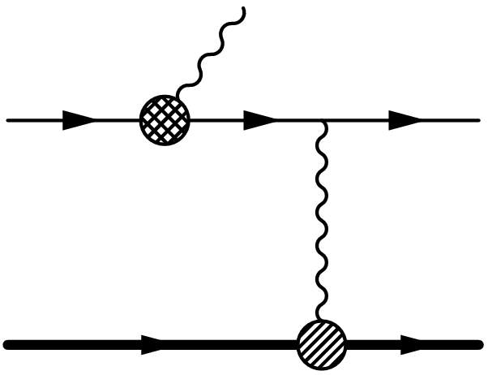
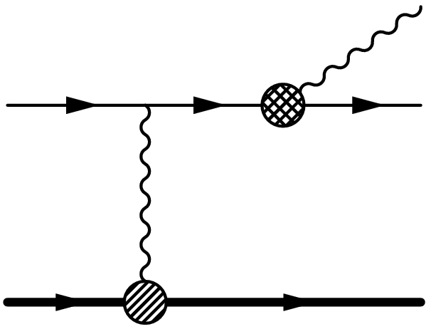
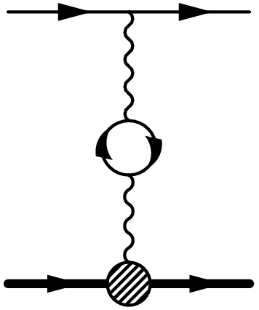
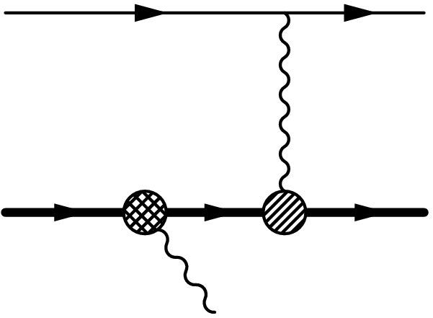
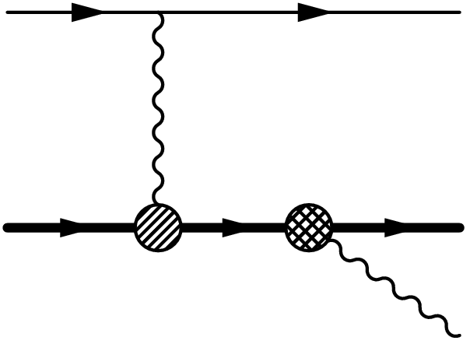
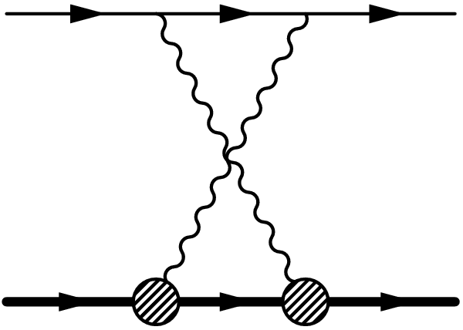
Radiative corrections

Slide 8
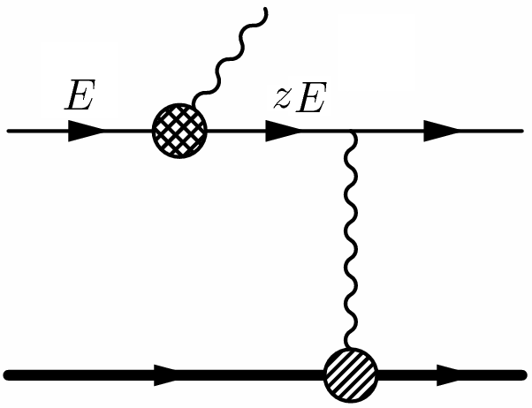

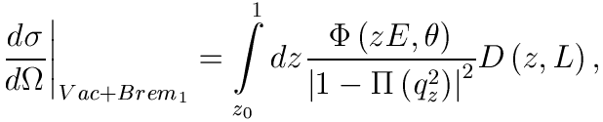

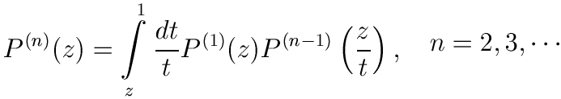
Radiative corrections: initial electron bremsstrahlung

Slide 9
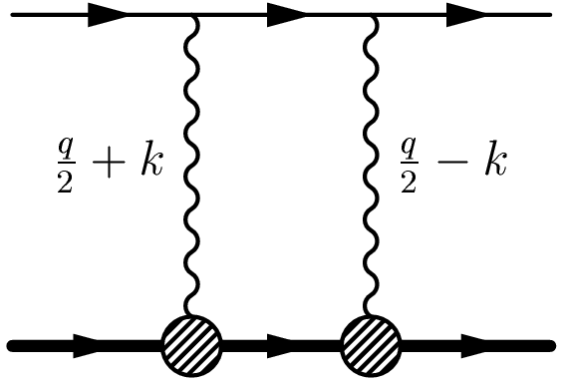

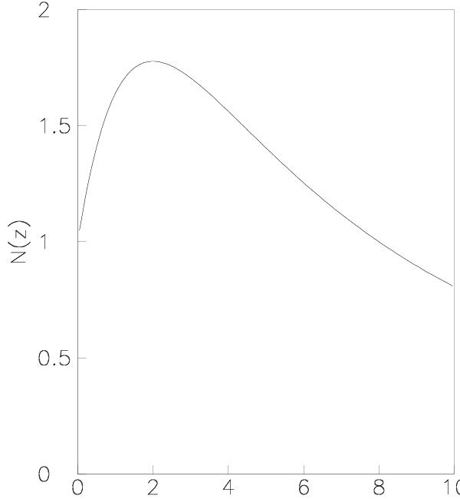
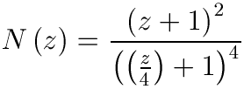
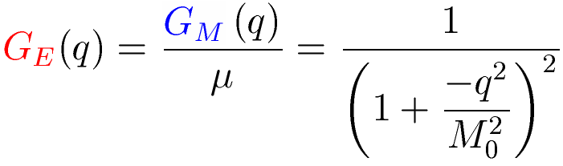


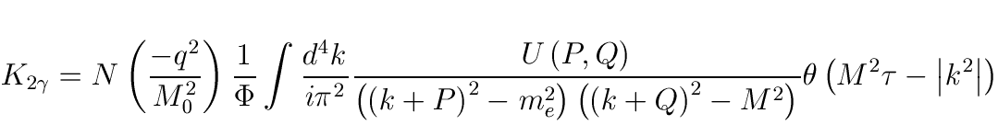
Radiative corrections: two-photon exchange

Slide 10
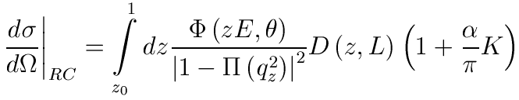

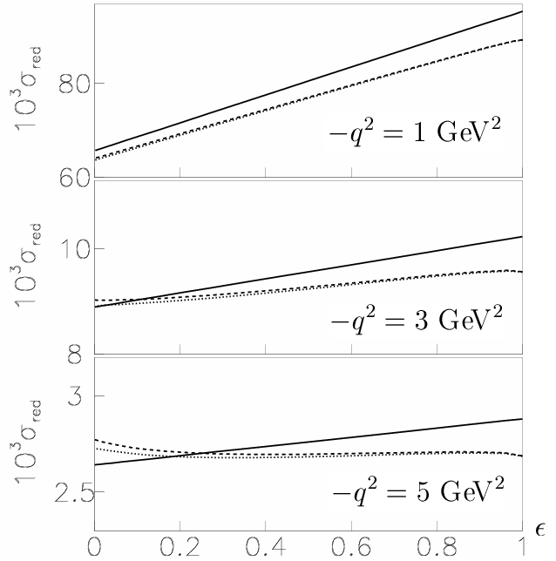
Contribution to unpolarized cross section

Slide 11
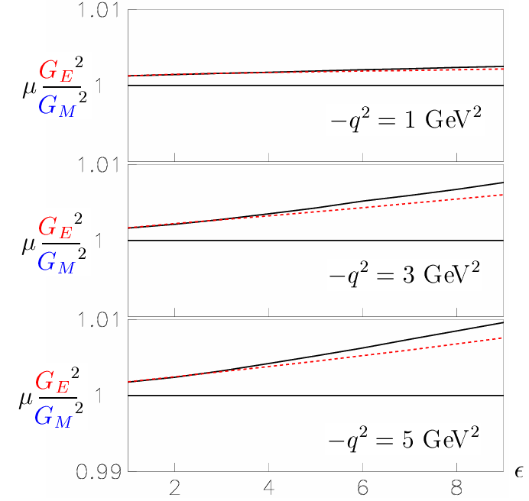
Contribution to ratio of polarized cross sections

Slide 12
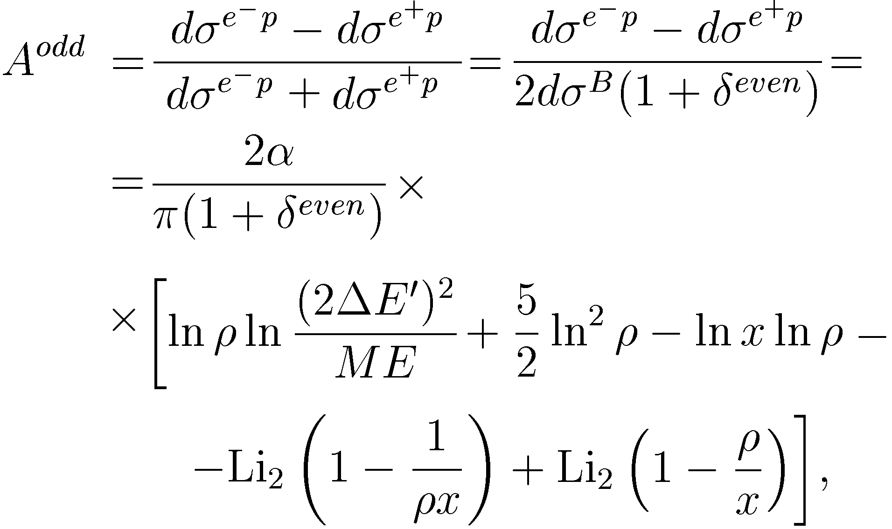

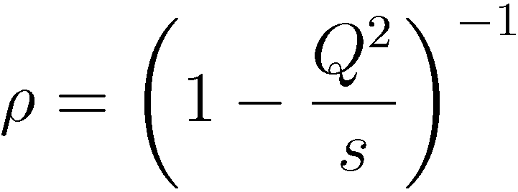
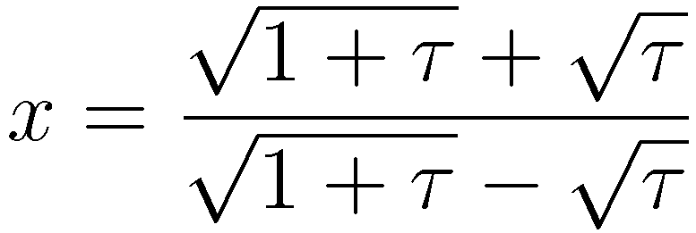
Charge asymmetry
The calculation of C-odd contributions into lepton-proton scattering was done in E.A. Kuraev, V.V. Bytev, S. Bakmaev
E. Tomasi-Gustafsson, Phys. Rev. C 78, 015205 (2008). For details of calculation listen the Talk of Prof. Kuraev

Slide 13
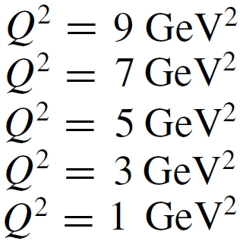
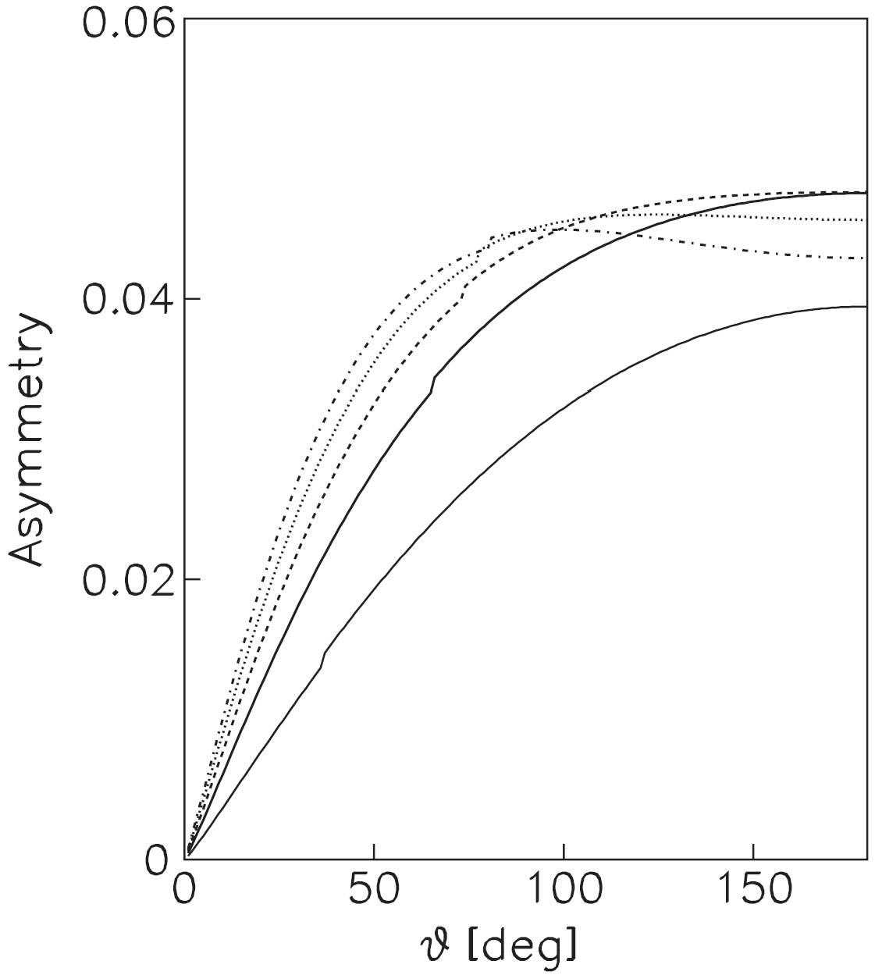
Charge asymmetry
The calculation of C-odd contributions into lepton-proton scattering was done in E.A. Kuraev, V.V. Bytev, S. Bakmaev
E. Tomasi-Gustafsson, Phys. Rev. C 78, 015205 (2008). For details of calculation listen the Talk of Prof. Kuraev

Slide 14
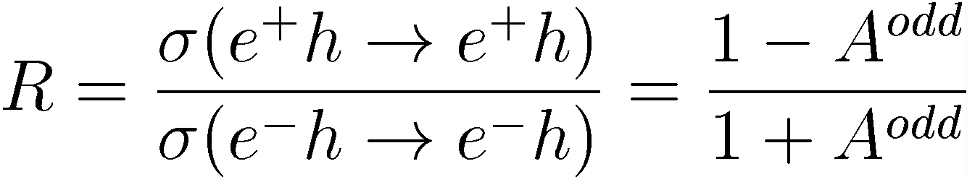
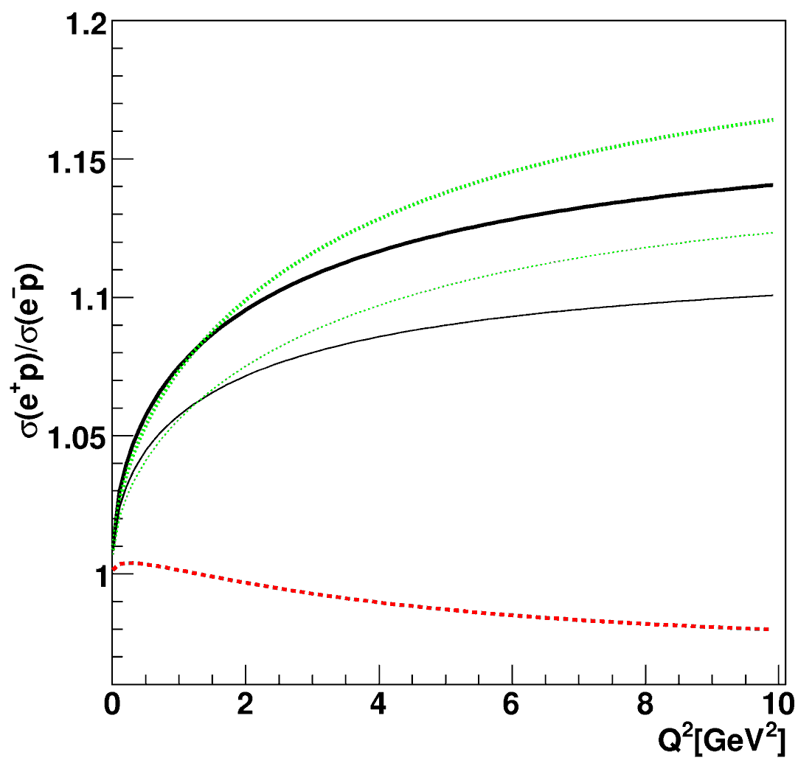
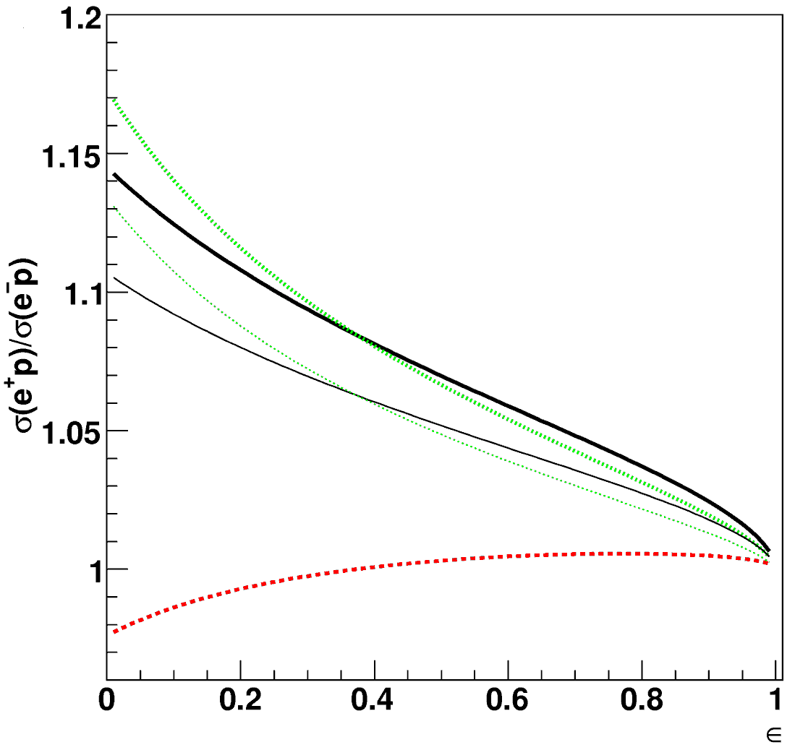
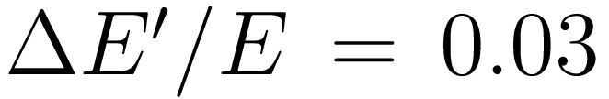


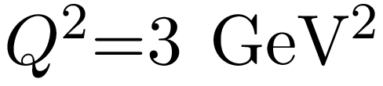
Charge asymmetry

Slide 15
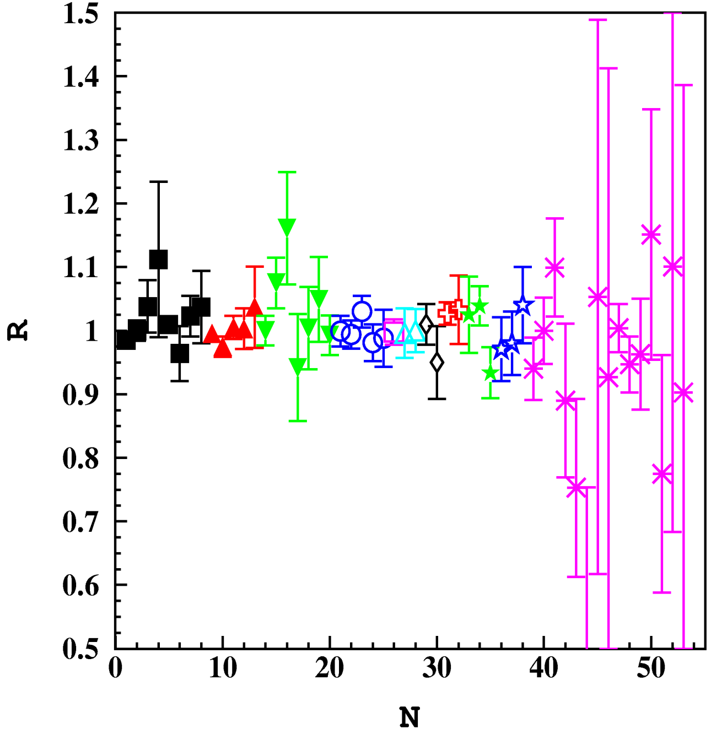
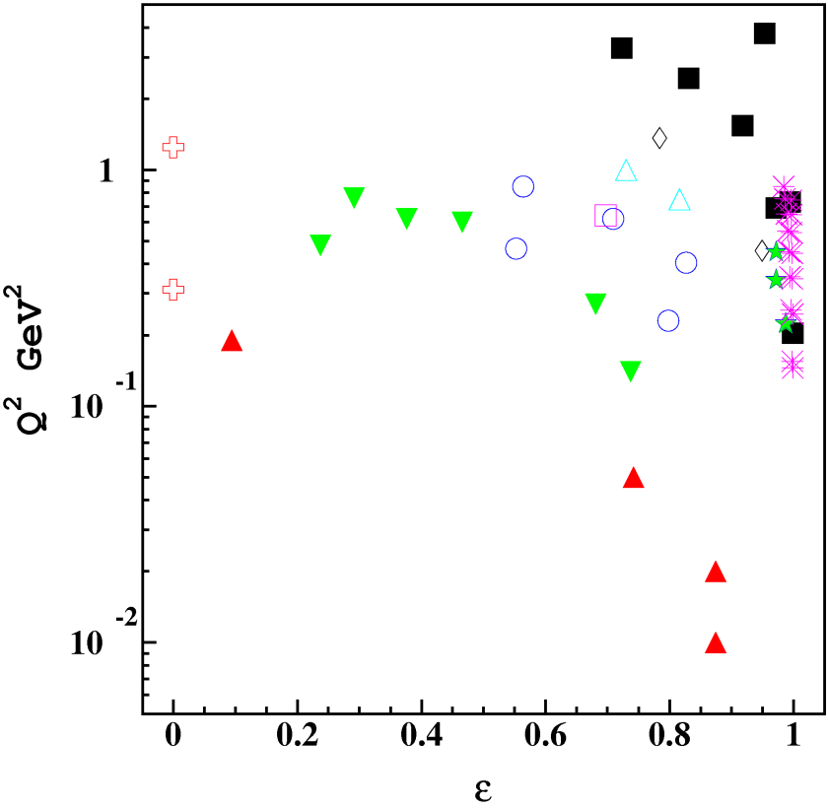
Charge asymmetry data: elastic scattering
Yount'1962
Browman'1965
Anderson'1966
Cassiday'1967
Bartel'1967
Mar'1968
Anderson'1968
Bouquet'1968
Camilleri'1969
Jostlein'1974
Hartwig'1975
Hartwig'1976
Hartwig'1979
Rochester'1976
Fancher'1976

Slide 16
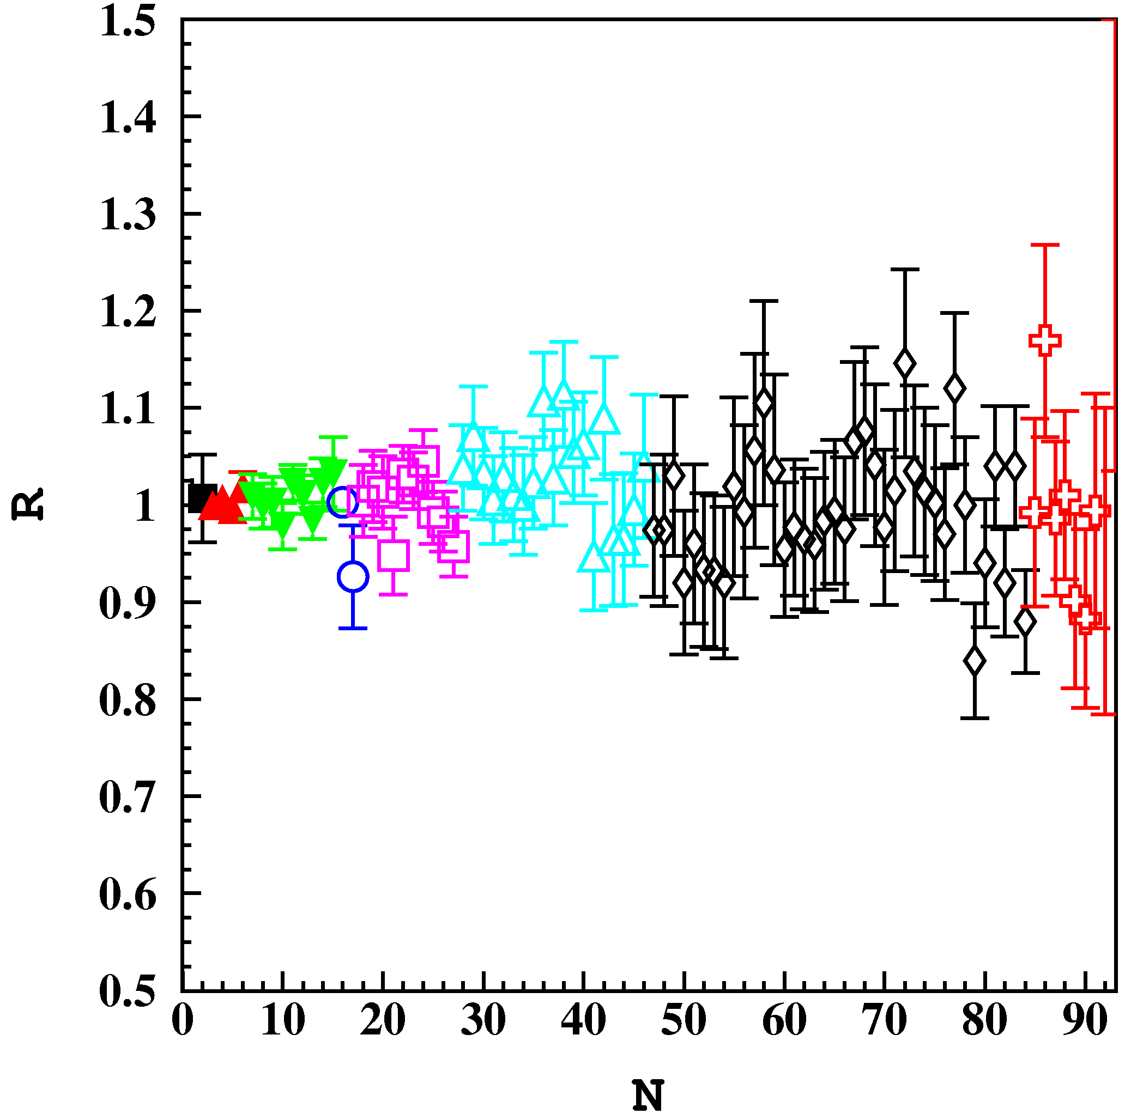
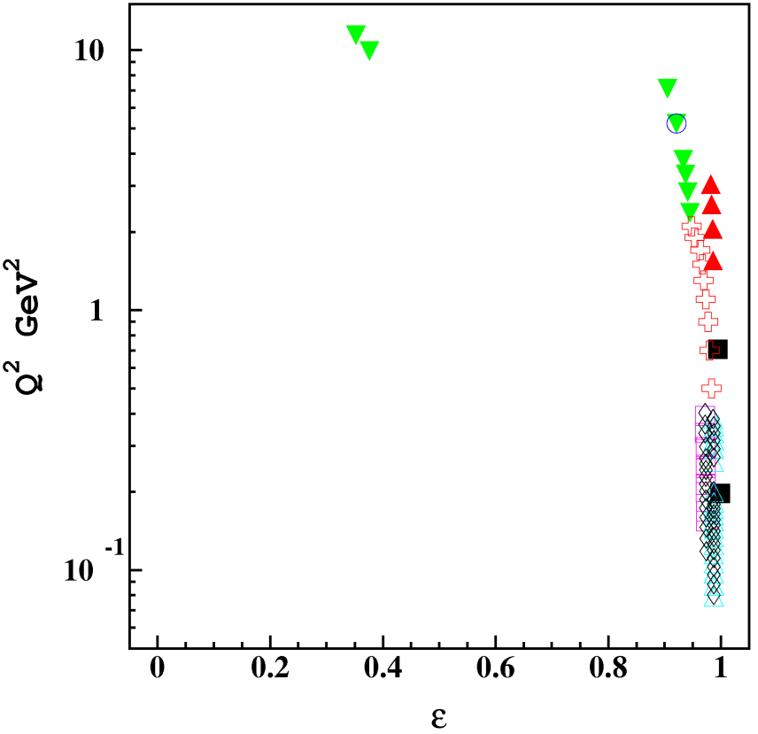
Charge asymmetry data: inelastic scattering
Mar'1968
Fancher'1976
Rochester'1976
Hartwig'1979
Hartwig'1976
Jostlein'1974

Slide 17


Puzzle
Formfactors obtained by polarization transfer and Rosenbluth techniques are inconsistent.
It has been argued that two-photon exchange may reconcile these measurements
(P.A.M. Guichon and M. Vanderhaeghen, PRL 91, 142303 (2003);
P.G. Blunden, W. Melnitchouk and J.A. Tjon, PRC 72, 034612 (2005);
A.V. Afanasev, S.J. Brodsky, C.E. Carlson, Y.C. Chen,
M. Vanderhaeghen, PRD 72, 013008 (2005)).

Slide 18




Puzzle
We assume that
And thus can evaluate the two-photon effects as
Y.C. Chen, C.W. Kao and S.N. Yang, Phys.Lett. B 652, 269 (2007).

Slide 19



Puzzle
Using this evaluation of two-photon effects (TPE) we can test the hypothesis that the difference between polarization transfer and Rosenbluth extraction is due to TPE contribution.
Assuming significance level of 0.05 we found the region excluded by this procedure.
Within our assumptions the data at cannot be reconciled by TPE contribution.

Slide 20
Conclusions
1. Two-photon exchange is small (< 1.5%).
2. Experimental data on the C-odd asymmetry in
lepton-proton scattering demonstrates small
contributions from two-photon effects.
3. These possible two-photon effects cannot explain
the difference of proton formfactors extracted in
Rosenbluth and polarizied setups.

