Slide 1
Эксперимент UA9 в CERN
Ю.М.Иванов, лаборатория мезоатомов

Slide 2
Кристаллическая коллимация: от У-70 к LHC
1997-2001 – первое применение коротких изогнутых кристаллов кремния для
вывода и коллимации протонов с энергией 70 ГэВ на У-70 в ИФВЭ
2002-2006 – первое применение упругоквазимозаичных кристаллов кремния,
наблюдение объемного отражения протонов с энергией 70 ГэВ
в ИФВЭ и 1 ГэВ в ПИЯФ
2006-2009 – коллаборация H8-RD22 в CERN: исследование объемного отражения
400 ГэВ протонов, многократного объемного отражения,
каналирования и объемного отражения отрицательных частиц,
излучения при объемном отражении электронов и позитронов
2009-2014 – коллаборация UA9 в CERN: исследование кристаллической
коллимации на протонном и ионном пучках SPS
2012-2016 – коллаборация LUA9 в CERN: исследование кристаллической
коллимации на протонном и ионном пучках LHC

Slide 3
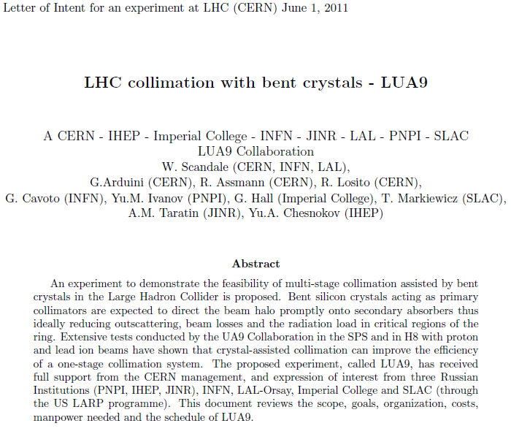
Letter of Intent for an experiment at LHC (CERN)

Slide 4
LoI представлено на LHCC 15 июня 2011

Slide 5
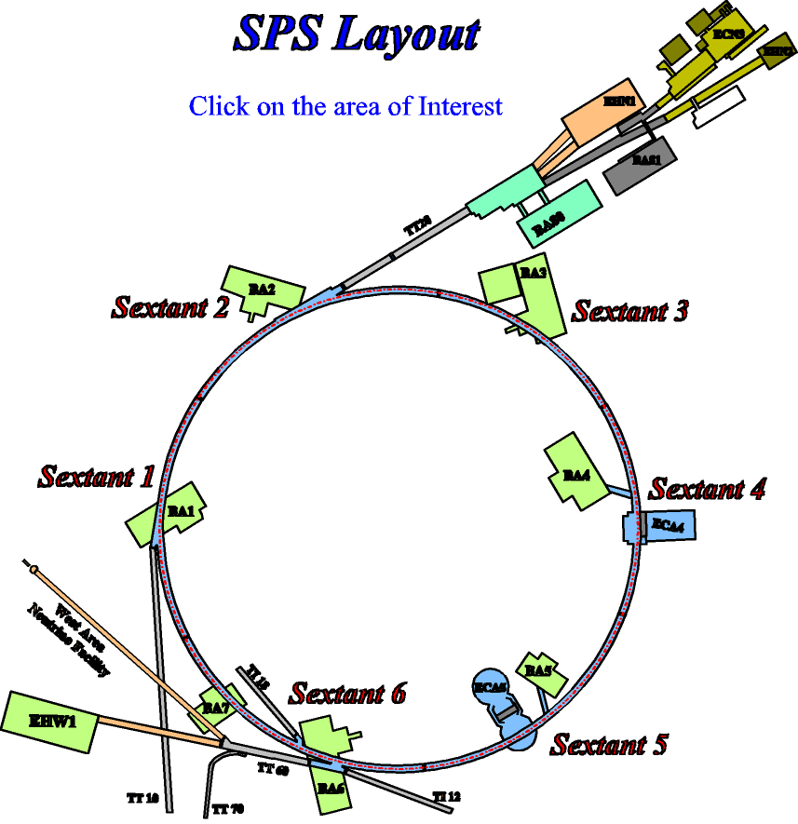
Местоположение UA9 на SPS
CCC
DAQ
(BB5)
SPS
(BA5)

Slide 6
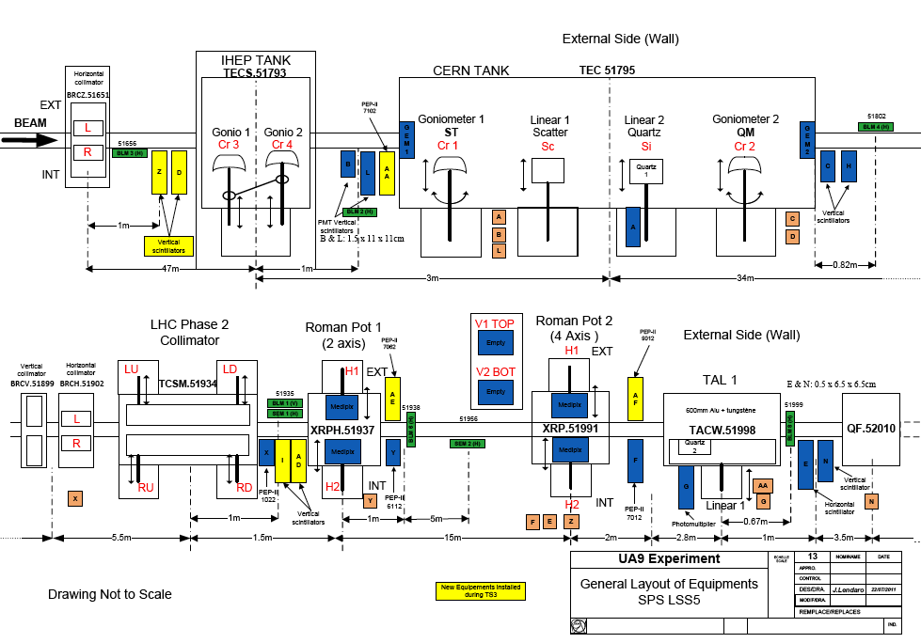
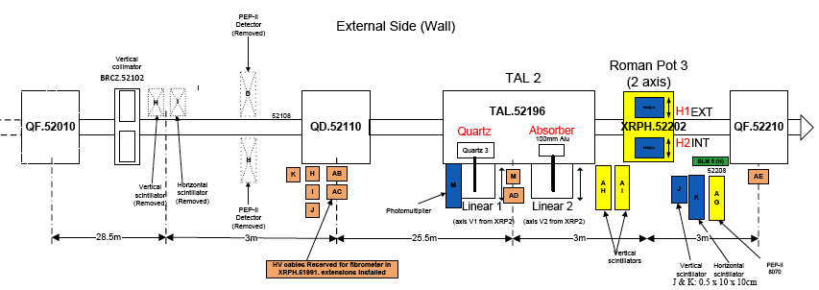
UA9 hardware in 2011
Collimation region
High dispersion area

Slide 7
UA9 basic layout
~ 67m / Δμ=90°
~45m / Δμ=60°
~ 45m / Δμ=60°
crystal4
crystal3
not used in 2011
1m Cu, LHC-type collimator
60 cm W absorber
10 cm Al scraper
Medipix in a two sided Roman pot
Medipix in a two sided Roman pot
Collimation region
High dispersion area
Observables in the collimation area:
Intensity, profile and angle of the deflected beam
Local rate of inelastic interactions
Channeling efficiency (with multi-turn effect)
Observables in the high-D area:
Off-momentum halo population escaping from collimation (with multi-turn effect)
Off-momentum beam tails

Slide 8
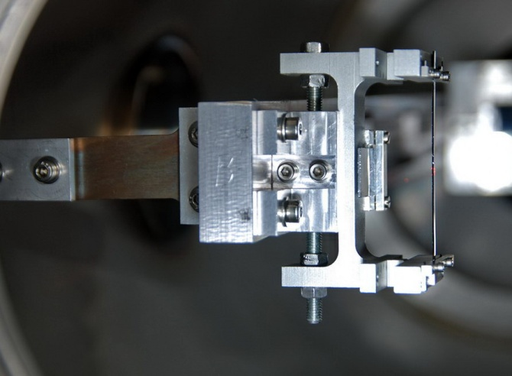
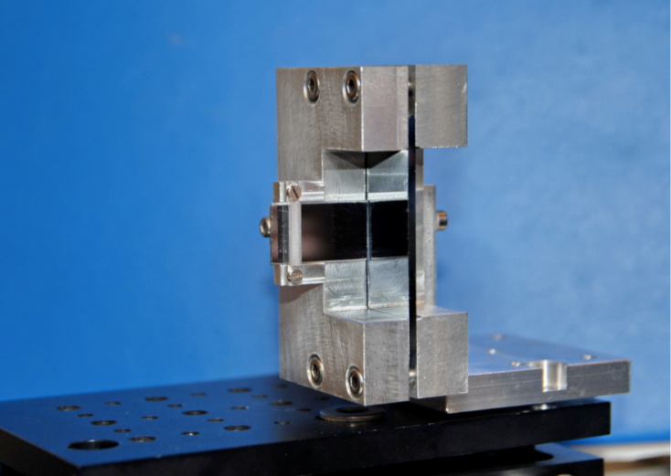
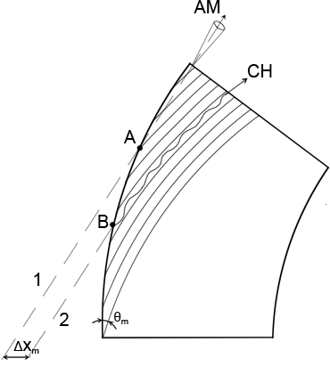
Crystals
Strip crystal 2mm long
Bent along (110) planes
Equidistant planes
Quasimosaic crystal 1.9 mm long
Bent along (111) planes
Non-equidistant planes d1/d2 = 3
Crystal 3
Crystal 4
Residual imperfections:
Residual torsion ≈ 1 μrad/mm
Amorphous layer size ≤ 1 μm
Miscut ≈ 100 μrad
➔ different paths for different vertical hit points
➔ different paths at small impact parameter
Torsion is no longer an issue
torsion over the beam size < critical angle
full mitigation of the detrimental effects
Schematic view of the residual miscut angle

Slide 9
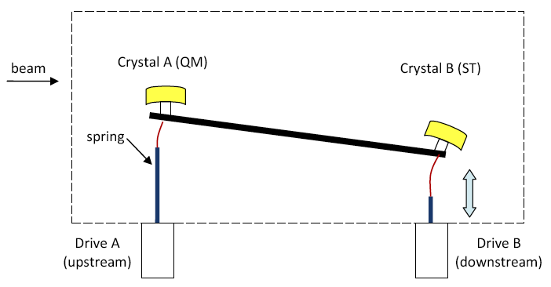
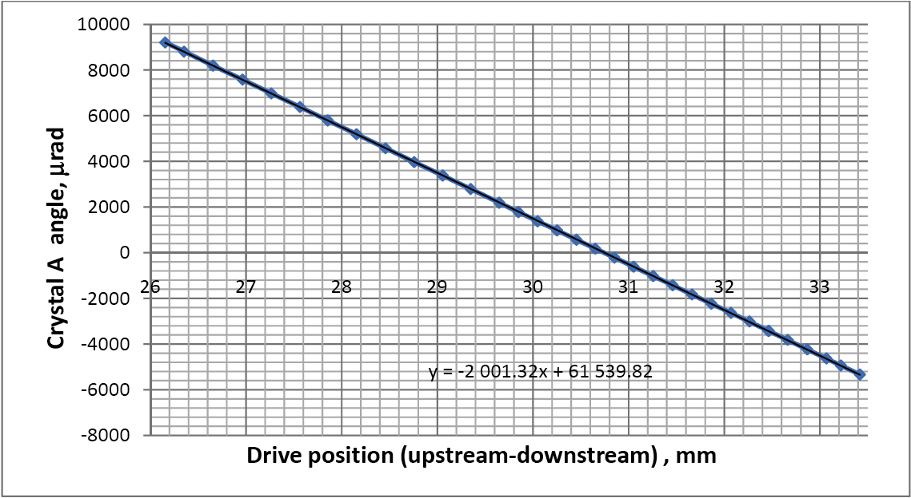
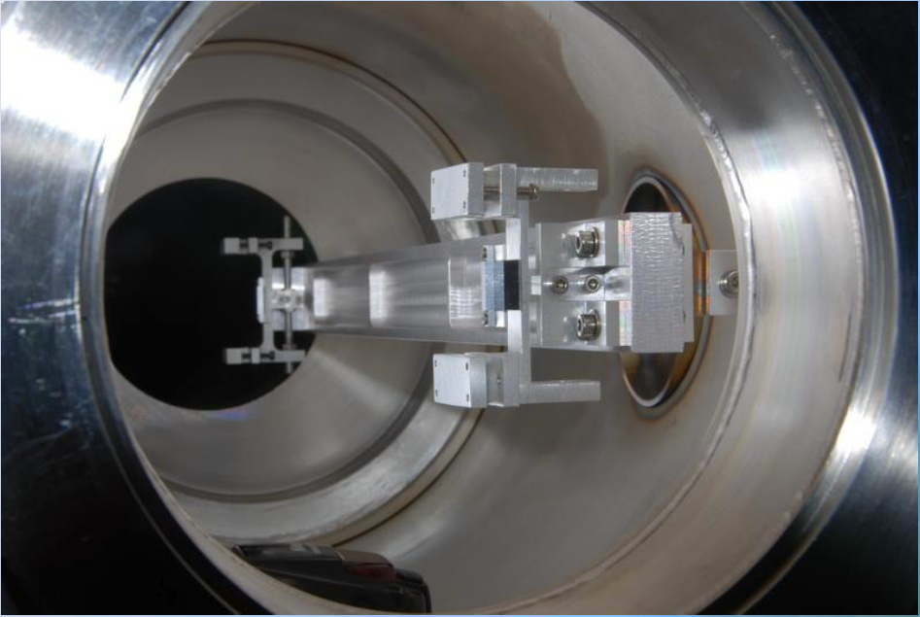
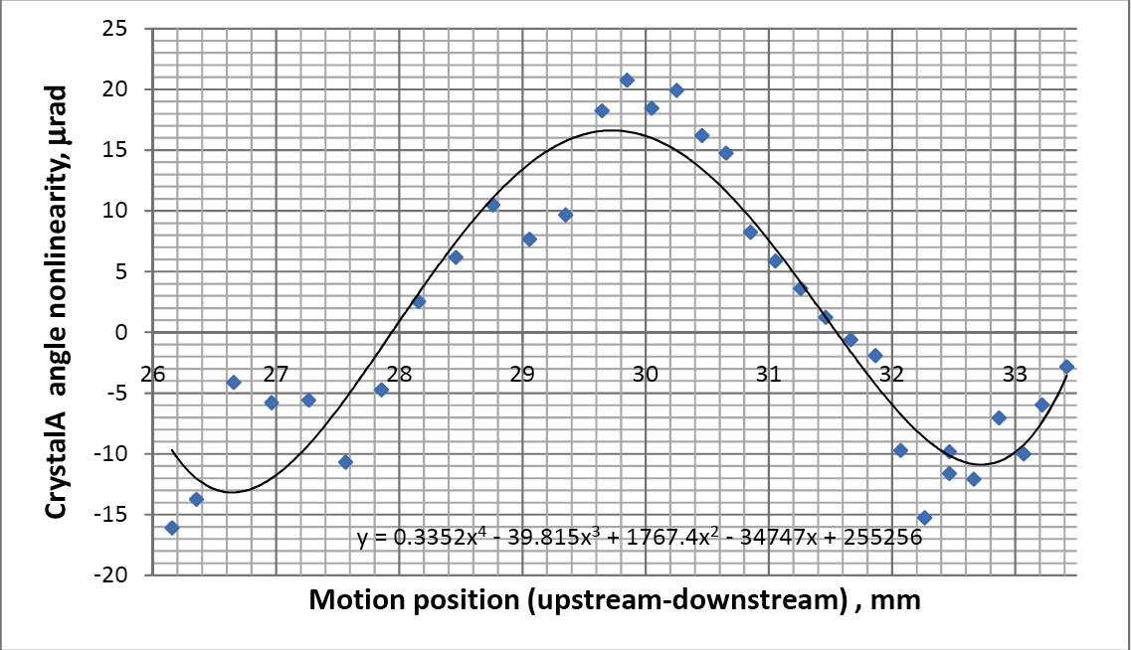
Goniometer
The critical angle governs the acceptance for crystal channeling
120 GeV➔θ_{c} = 20 μrad
270 GeV➔θ_{c} = 13.3 μrad
Transfer function
residual inaccuracy
|δϑ| ≤ 10 μrad
Non-linear part of the transfer function
in a full angular scan
the drive position changes by 300 µm around the initial value in the plotted range

Slide 10
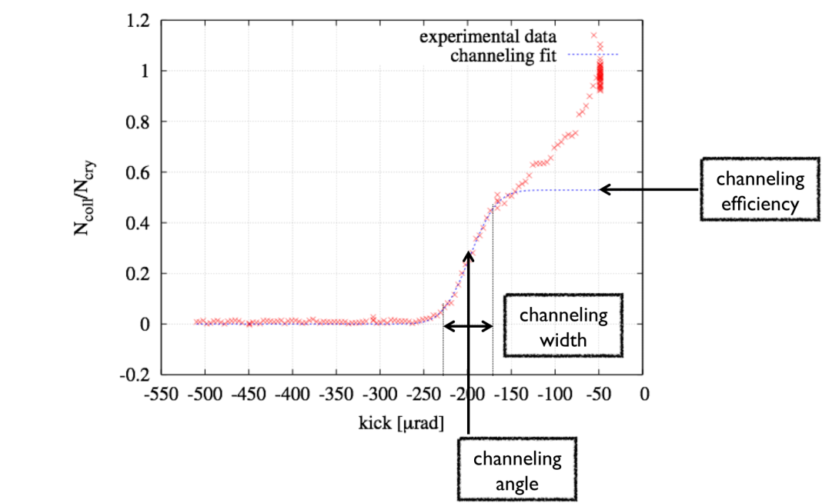
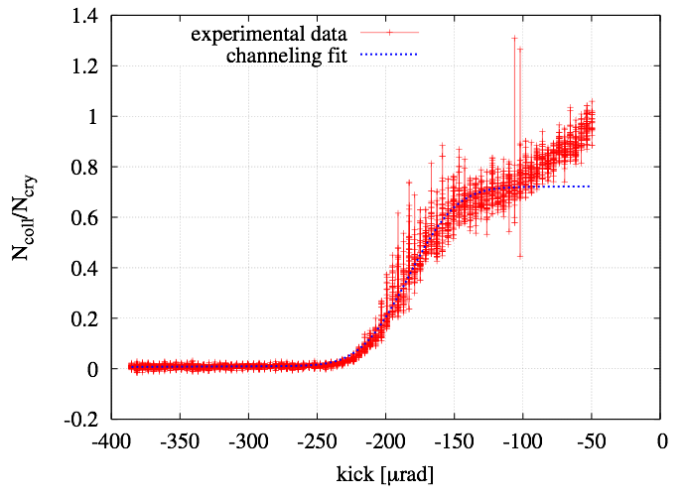
Channeling efficiency bycoll. scans
~ 67m / Δμ=90°
~45m / Δμ=60°
~ 45m / Δμ=60°
absorber
collimator
Crystal 3
Proton beam at 120 GeV
BLMs
Pb-ion beam at 120 GeV
Efficiency 70-85%
Efficiency 50-74%
Ncoll/Ncry [-]
channeling kick
Equivalent crystal kick[μrad]

Slide 11
Loss rate reduction at the crystal
~ 67m / Δμ=90°
Loss rate reduction factor
for protons 5÷8
for lead ions ≈ 3
σ_{tot}(lead ions)=σ_{h}+σ_{ed}=5.5 b≅10×σ_{tot}(p)
Nuclear spray
absorber
Loss rate counters
protons
Lead ions
simulation
simulation
data
×5÷8 reduction
×3 reduction
data

Slide 12
off-momentum halo population
~ 67m / Δμ=90°
~45m / Δμ=60°
Off-momentum halo
deflected in the dispersive area of the TAL2
Absorber
P, Pb: diffractive scattering and ionization loss
Scraper
(TAL2)
Nuclear spray
Medipix in a two sided Roman pot
BLMs
Off-momentum halo population
Linear scan made by the TAL2 (or Medipix) with the crystal in fixed orientation
angular scan of the crystal with the TAL2 (or the Roman pot) in fixed position in the shadow of the absorber

Slide 13
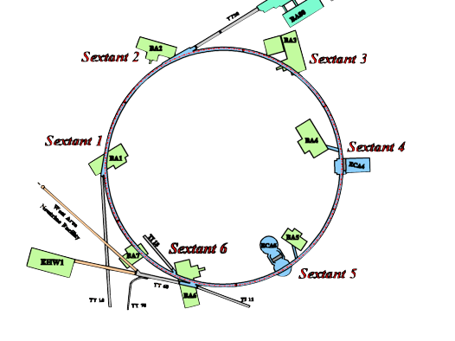
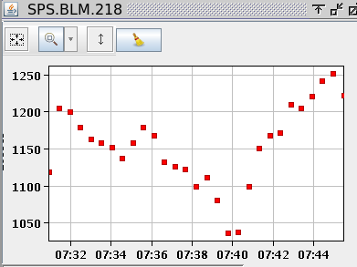
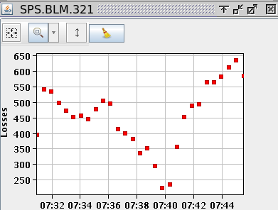
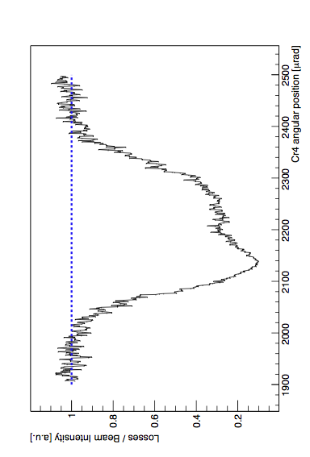
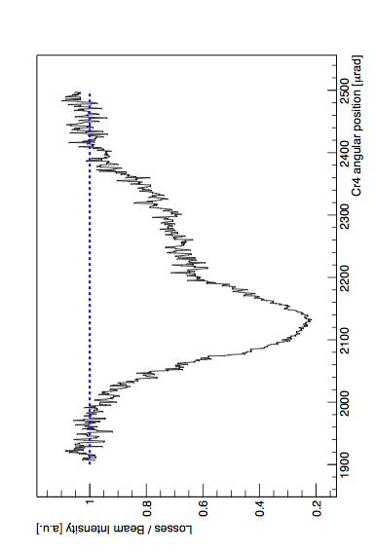
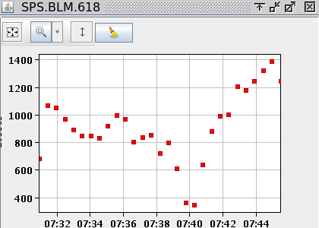
Main result from UA9 in 2011: with high beam intensity the loss reduction at the collimation insertion reproduced in all the sextants !
Sextant 5: Crystal collimation insertion
Crystal at 5.6 σ Absorber at 7.6 σ Scraper at 9.3σ
amorphous
amorphous
5x
10x
channeling
channeling
reduction of losses at the crystal collimator
... and ~ 130 m downstream (dispersive area)
Notes:
UA9 crystal assisted collimation:
Setup:
Crystal at 5.6 sigma
TAL (W asbosrber) at 7.6 sigma
TAL2 (al target) at 9.3 sigma
The halo is collected by the crystal and deflected towards the TAL-absorber with a single-pass efficiency of 80% and a multi-pass efficiency of close to 1.
The diffractive particle are produced in the crystal colinear to the beam envelope thus are NOT collected by the TAL absorber
These particles are deviating from the beam envelope in the dispersion suppressor downstream.
They are thus collected by the scraper
Those escaping also from the scraper are collected in the various sextant.
In channeling secondary halo is reduced by a factor of 10 whilst the tertiary halo essentially made of off-momentum particle is reduced by a factor of 5 in the dispersion suppressor and by a factor of 2 at lest in the sextants

Slide 14
Perspective for 2012
The extension of UA9 to LHC is seen favorably by LHCC and by the accelerator directorate (to be announced soon)
time allocation in LHC to be shared in between the machine and the experiments (however very limited)
dedicated run time to avoid conflicts with the high-luminosity operation.
UA9 in the North Area and in the SPS
The main goal will be to validate scenarios, detectors and hardware for LHC
Upgrade of the SPS experimental setup required
crystal collimation scheme for the high-intensity SPS operation.
Preliminary investigations based on UA9 experimental setup
Later an ad-hoc setup is required.
The collimation is requested at high-energy in pulsed mode
Very demanding constraints on crystal acceptance and on goniometer stability
UA9 request to the SPSC
5 days in the SPS (4 with protons and 1 with Pb-ions)
5 weeks in H8 (3 with protons and 2 with Pb-ions)

Slide 15
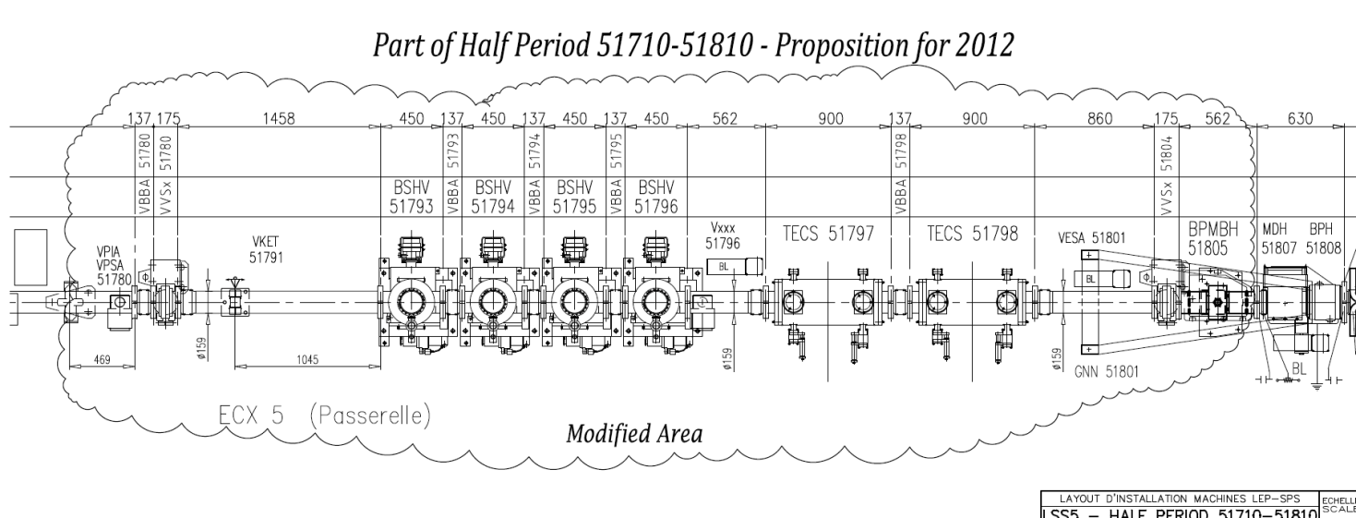
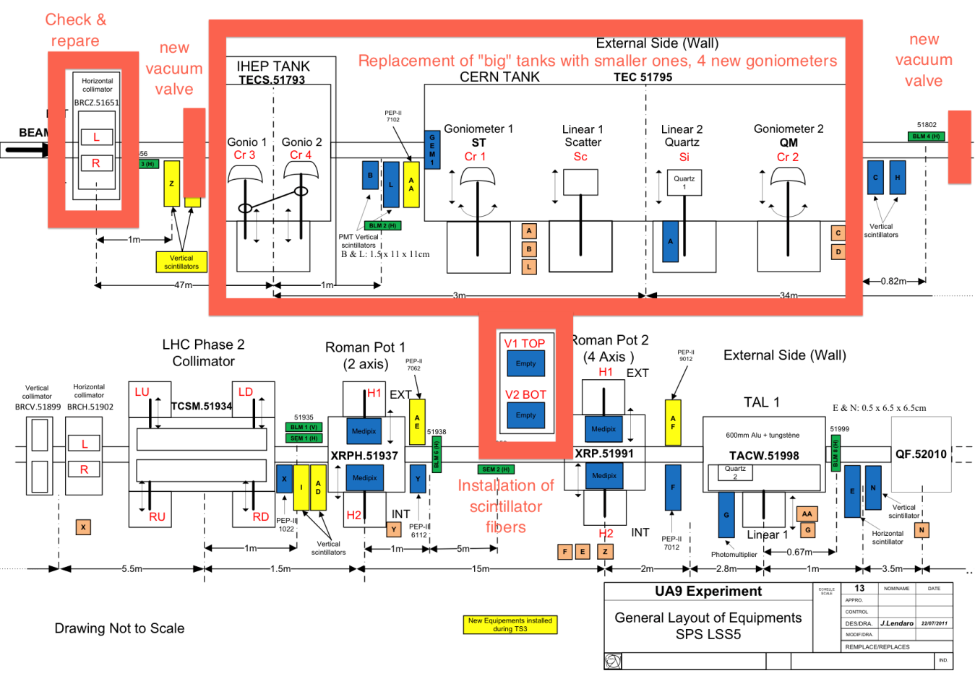
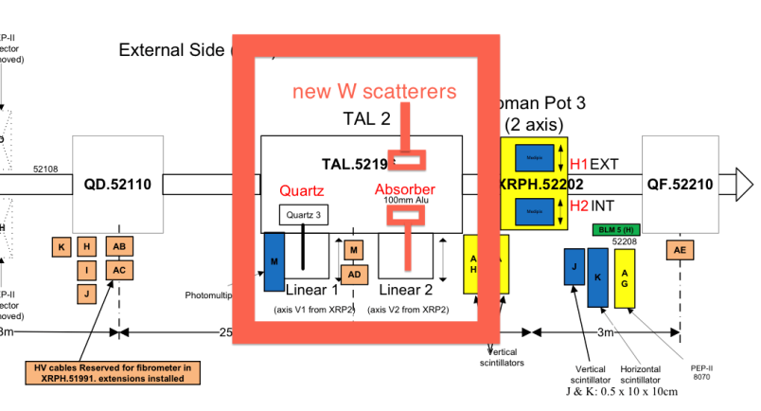
New hardware and priorities for 2012
SPS – 5 full days
High intensity, high flux operation for loss maps along the SPS
Operation with Pb-ions
Hardware test for LHC (crystals and goniometer)
Collimation efficiency of multi-strip crystals
H8 – 5 weeks
Test of new crystals for LHC
Test of instrumentation for LHC
Deflection efficiency withPb-ions
x-ray spectraPXRas a tool to detect the crystal integrity

Slide 16
Публикации 2009
Experimental study of the radiation emitted by 180-GeV/c electrons and positrons volume-reflected in a bent crystal, Physical Review A 79, 012903 (2009)
Observation of Multiple Volume Reflection of Ultrarelativistic Protons by a Sequence of Several Bent Silicon Crystals, Physical Review Letters 102, 084801 (2009)
Observation of nuclear dechanneling for high-energy protons in crystals, Physics Letters B 680 (2009) 129–132
High-efficiency deflection of high-energy negative particles through axial channeling in a bent crystal, Physics Letters B 680 (2009) 301–304
Observation of channeling and volume reflection in bent crystals for high-energy negative particles, Physics Letters B 681 (2009) 233–236
First observation of multiple volume reflection by different planes in one bent silicon crystal for high-energy protons, Physics Letters B 682 (2009) 274–277

Slide 17
Публикации 2010
Multiple volume reflections of high-energy protons in a sequence of bent silicon crystals assisted by volume capture, Physics Letters B 688 (2010) 284–288
Deflection of high-energy negative particles in a bent crystal through axial channeling and multiple volume reflection stimulated by doughnut scattering, Physics Letters B 693 (2010) 545–550
Probability of inelastic nuclear interactions of high-energy protons in a bent crystal, Nuclear Instruments and Methods in Physics Research B 268 (2010) 2655–2659
First results on the SPS beam collimation with bent crystals, Physics Letters B 692 (2010) 78–82

Slide 18
Публикации 2011
Observation of multiple volume reflection by different planes in one bent silicon crystal for high-energy negative particles, EuroPhysics Letters , 93 (2011) 56002
Observation of parametric X-rays produced by 400 GeV/c protons in bent crystals, Physics Letters B 701 (2011) 180–185
Comparative results on collimation of the SPS beam of protons and Pb ions with bent crystals, Physics Letters B 703 (2011) 547–551
The UA9 experimental layout, JINST 6 T10002 (2011)

